Slide 1
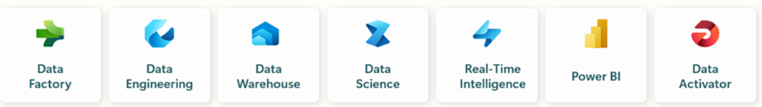

Slide 2

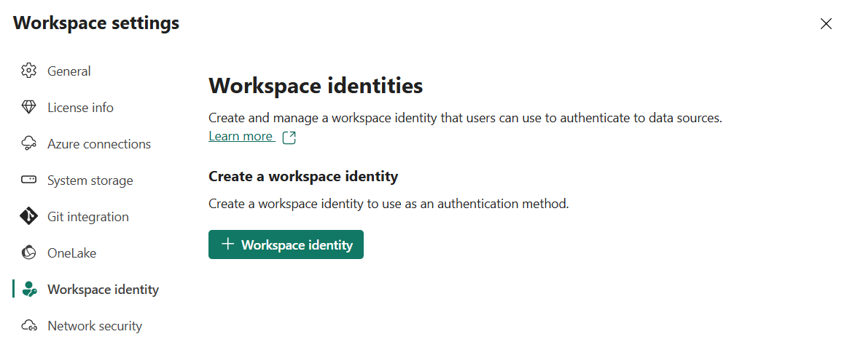
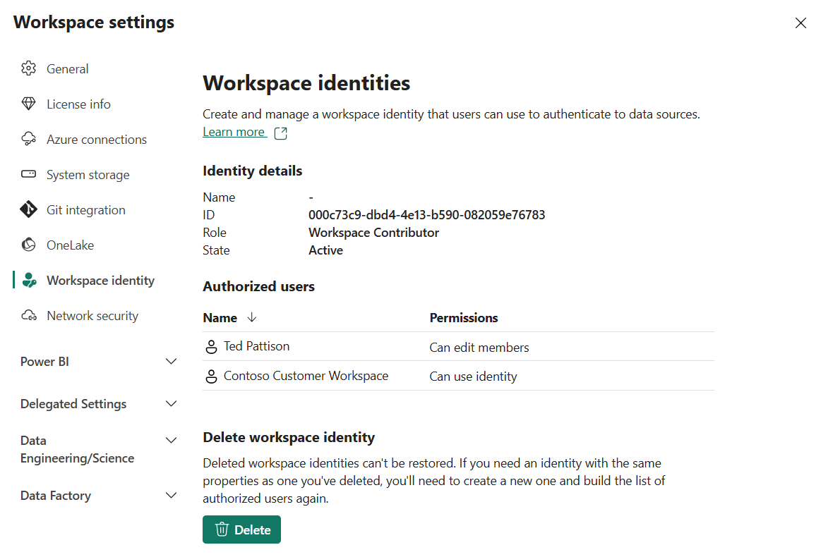

Slide 3
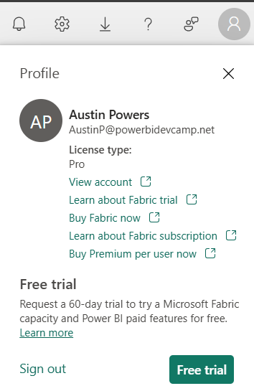
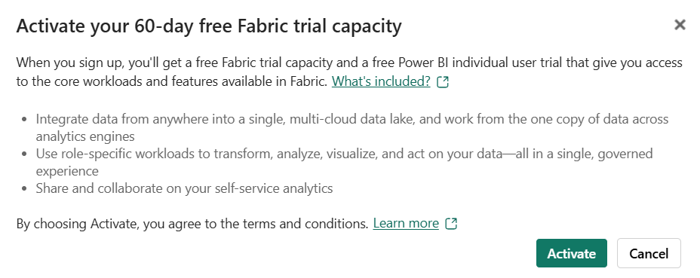

Slide 4





Workspace (Power BI solution)
Semantic Model
Report
Workspace (Data Engineering solution)
Lakehouse
Notebook
Environment
Workspace (Multi-workload solution)
Lakehouse
Notebook
Semantic Model
Report

Slide 5








Workspace (Data Warehouse solution)
Warehouse
Lakehouse
Data Pipeline
Workspace (Real-time Intelligence solution)
Eventhouse
Eventstream
KQL Database
KQL Queryset
KQL Dashboard
Reflex item

Slide 6

Fabric Multi-tenant Environment
Entra Id Tenant Owned by ISV
Tenant Workspace for Customer 1
Lakehouse
Notebook
Semantic Model
Report
Customer 01
17 users
Custom ISV Application
Tenant Workspace for Customer 2
Lakehouse
Notebook
Semantic Model
Report
Customer 02
85 users
Tenant Workspace for Customer N
Lakehouse
Notebook
Semantic Model
Report
Customer N
450 users

Slide 7
Customers
ISV Application
SaaS platform
Fabric REST APIs
PaaS platform
Call as User
Call as Service Principal

Slide 8

ISV Application
Fabric REST APIs
access token
JSON Result
HTTP Response: 200 OK

Slide 9
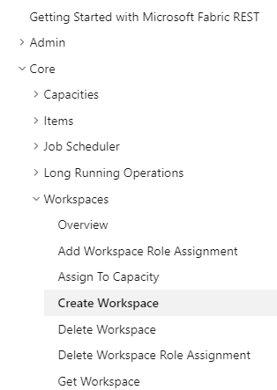
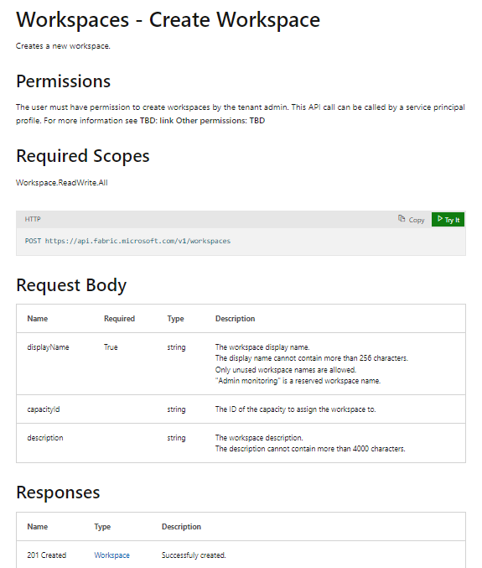

Slide 10
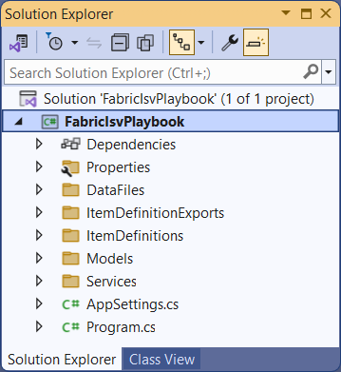
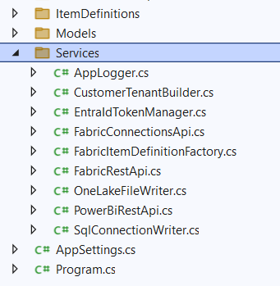

Slide 11
FabricItemDefinitionFactory
FabricRestApi
Program
CustomerTenantBuilder
PowerBiRestApi
EntraIdTokenManager
OneLakeFileWriter
SqlConnectionWriter

Slide 12

Custom ISV Application
Fabric Environment
Customer Workspace
OneLake Shortcut
Outbound Security
Connection to external Datasource
ADLS Gen2
Storage Container
Inbound Security
Calls to Fabric REST API
Semantic Model
Outbound Security
Connection to external Datasource
Azure
SQL Database

Slide 13
Customer Workspace
Fabric Environment
OneLake Shortcut
Outbound Connection
ADLS Gen2
Storage Container
AzureDataLakeStorage
Semantic Model
Outbound Connection
Azure
SQL Database
SQL
Connectors

Slide 14
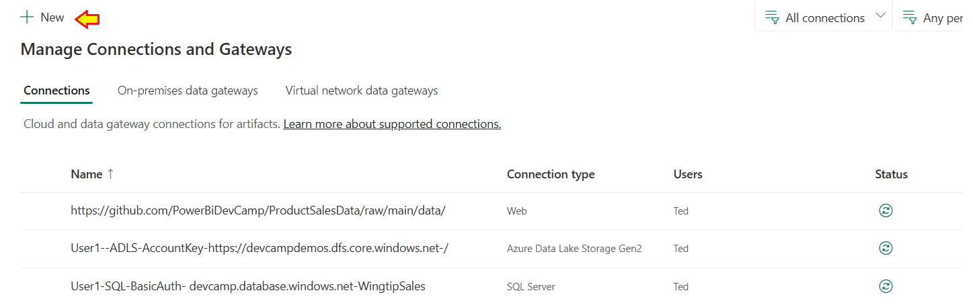
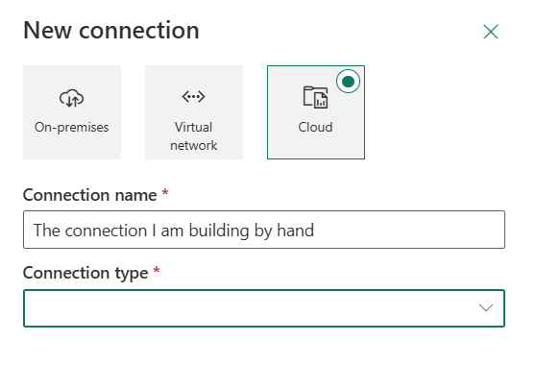

Slide 15
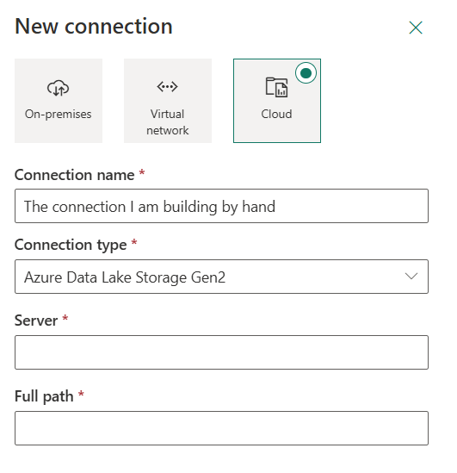
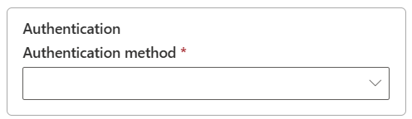
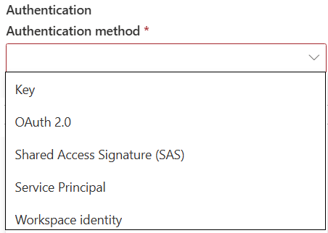

Slide 16
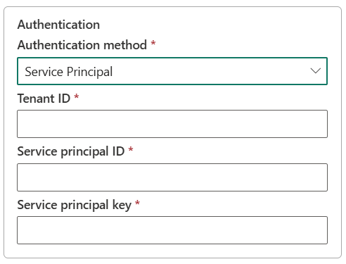

Slide 17
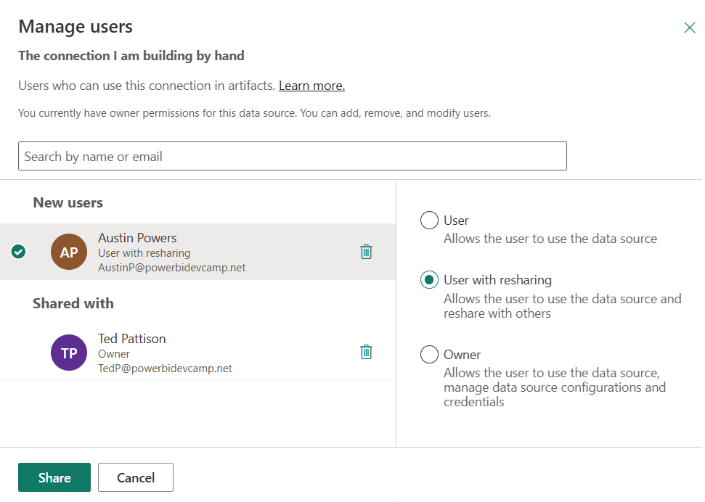

Slide 18
Custom ISV Application
Fabric REST API
Entra Id Tenant Owned by ISV
call as user
User
Token
call as service principal
Service Principal
Token

Slide 19




Fabric Multi-tenant Environment
Azure AD Tenant Owned by ISV
Customer 01 Tenant Workspace
Customer 01
17 users
lakehouse
notebook
model
report
Custom ISV Application
Customer 02 Tenant Workspace
lakehouse
notebook
model
report
Customer 02
85 users
Customer N Tenant
lakehouse
notebook
model
report
Customer N
450 users

Slide 20






Workspace (Power BI solution)
model
report
Workspace (Data Engineering solution)
lakehouse
notebook
environment
KQL database
KQL queryset
Workspace (Data Warehouse solution)
lakehouse
warehouse
data pipeline
RT dashboard
xxxx
Workspace (multi-workload solution)
lakehouse
notebook
model
report

Slide 21
Azure Web Application
Entra Id Service
Your Application
Request to acquire access token
Result with
access token
HTTP Response: 200 OK

Slide 22
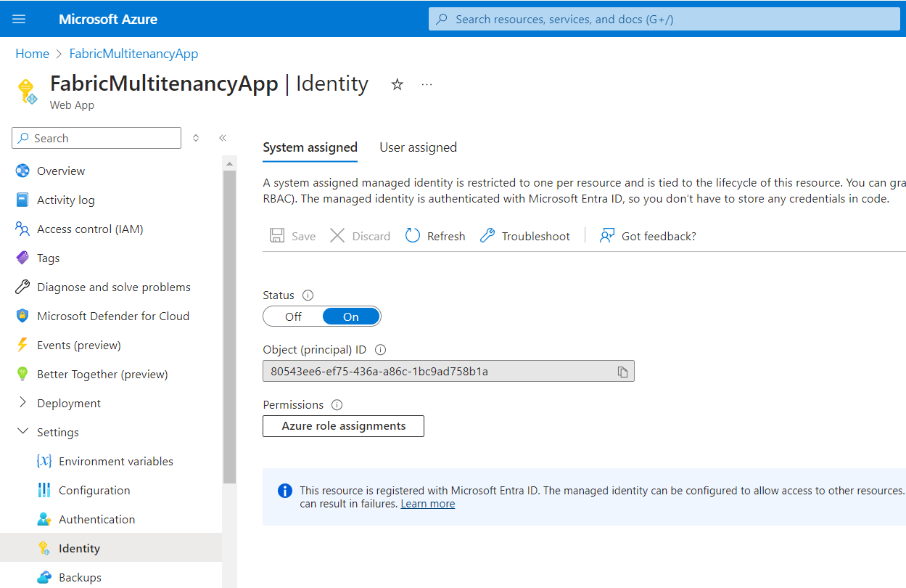

Slide 23


Slide 25
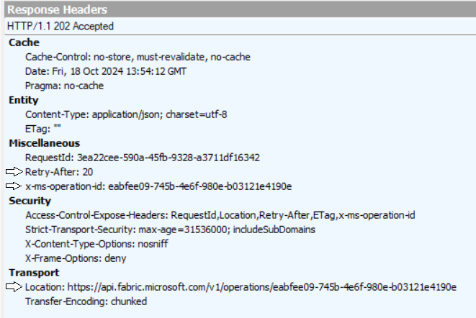

Slide 26
Fabric Environment
Entra Id Tenant
Workspace 1
Capacity (F4)
Workspace 2
Capacity (F16)
Workspace 3
Workspace 4
Capacity (F64)
Workspace 5
Workspace 6
Workspace 7
Workspace 8

Slide 27
Platform Item Types
Capacity
Workspace
Connection
Gateway
Workspace Item Types by Workload
Power BI
Data Engineering
Data Warehouse
Data Factory
Real-time Intelligence
Data Science
SemanticModel
Lakehouse
Warehouse
DataPipeline
Eventhouse
MLExperiment
Report
Notebook
MirroredWarehouse
Dataflow
Eventstream
MLModel
SparkJobDefinition
KQLDatabase
Environment
KQLQueryset
KQLDashbord

Slide 28
Creatable Workspace Item Types by Workload
Data Engineering
Power BI
Data Warehouse
Data Factory
Real-time Intelligence
Data Science
Lakehouse
SemanticModel
Warehouse
DataPipeline
Eventhouse
MLExperiment
Notebook
Report
MirroredWarehouse
Dataflow
Eventstream
MLModel
SparkJobDefinition
KQLDatabase
Environment
KQLQueryset
KQLDashbord

Slide 29
displayName:
Create Bronze Layer
type:
Notebook
description:
A sample notebook
definition:
parts: {
}
notebook-content.py

